Slide 1



Hardware and Software Fundamentals of Intelligent Computing Systems

Slide 2
Lecture 48: Emerging Technology Outlook and Course Summary
Notes:
内容：回顾 FlagOS 体系，探讨 AI 系统软件的未来（WebGPU, MoE, TPU 等）。FlagOS 结合： 展望 FlagOS-Robo (具身智能工具包) 等新兴方向。

Slide 3
Towards Sustainable AI and AGI
In the previous lecture notes:
Module 1: Fundamentals of AI System and Heterogeneous Computing
Module 2: High-Performance AI Operators and Operator Engineering
Module 3: Principles and Optimization of AI Compilers
Module 4: Distributed Parallel Training & Inference and Communication
Module 5: Performance Evaluation and AI-assisted Kernel Generation

Slide 4
Driving Forces in the Near Future
Scaling law (pre-train, post-train, test-time)
Agentic workflow and multi-agent system
Embodied AI and world models

Slide 5
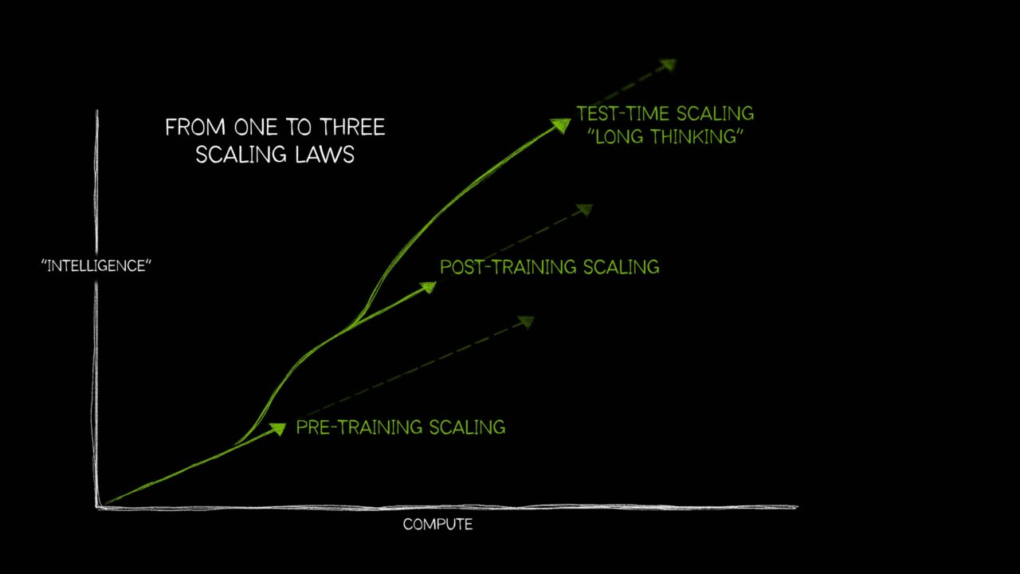
Need Design-for-10X AI System & Software
Pre-train scaling
Post-train scaling
Test-time scaling
image source: nvidia.com

Slide 6
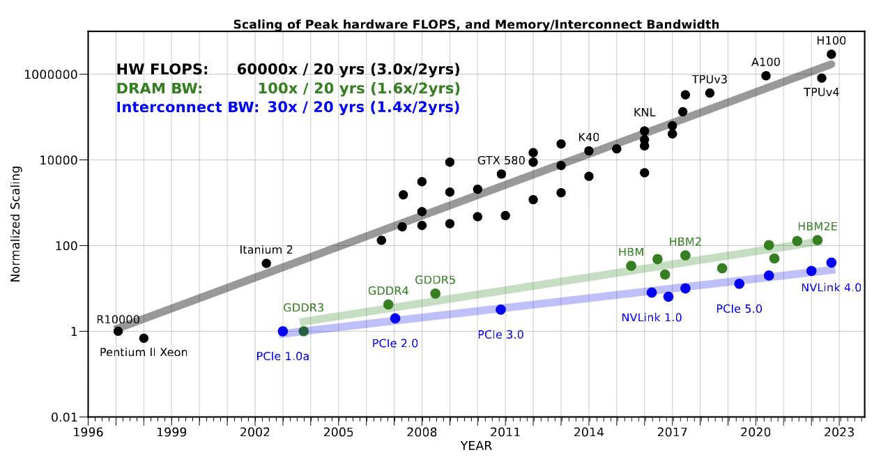
Hardware Challenges
Why does the bottleneck persist after Moore's Law slows down?
Memory:
HBM bandwidth grows far more slowly
GPUs spend significant time waiting for data
Power:
Dennard Scaling ended around 2005
Interconnect:
Multi-GPU comm > 30% of training time
Memory Wall
Power Wall
Interconnect Wall
~2% / yr
700 W+
400 GB/s
DRAM bandwidth annual growth
H100 SXM single-card TDP
PCIe 5.0 peak bandwidth

Slide 7
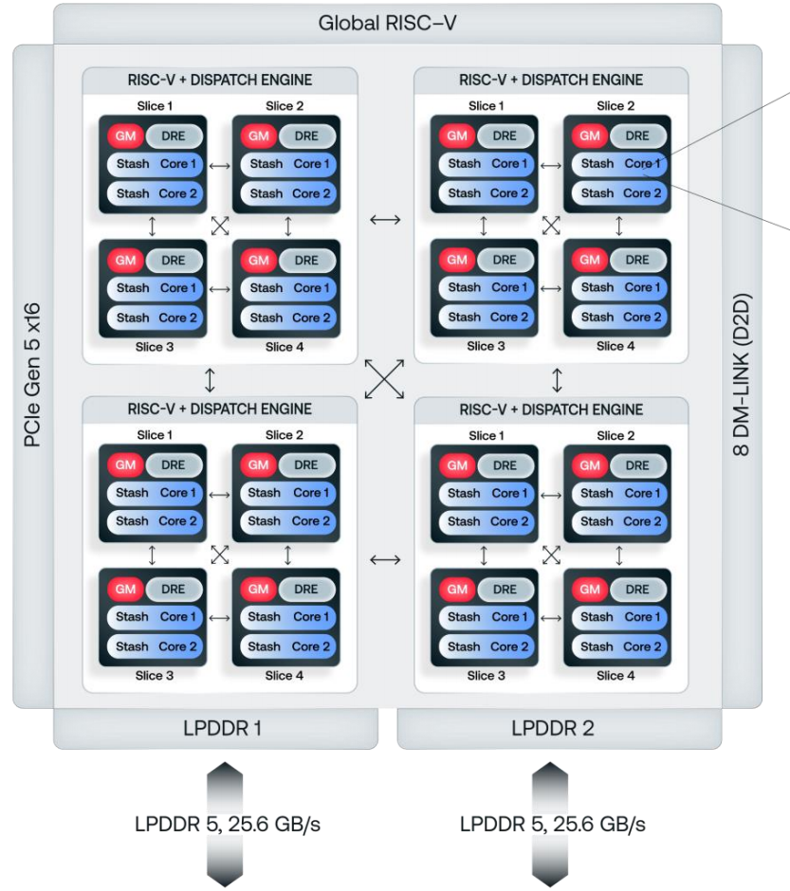
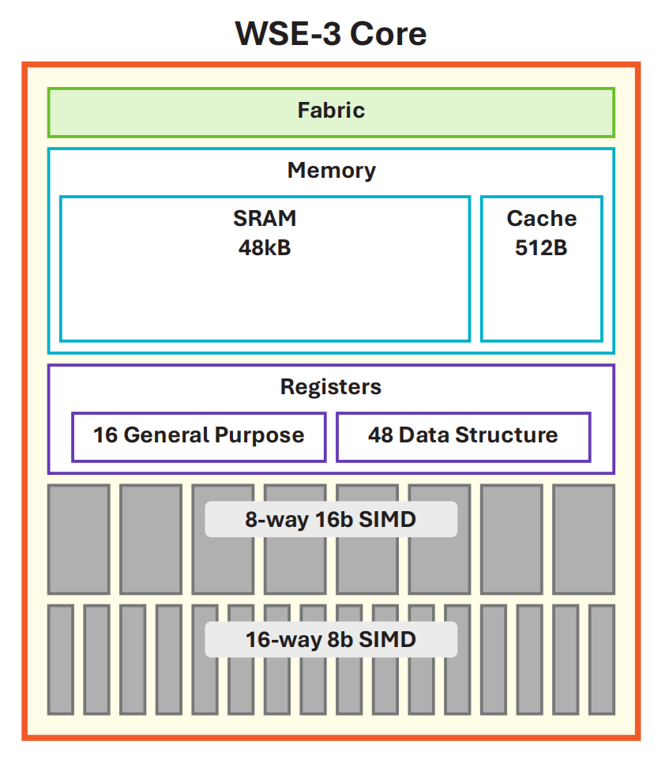
Emerging Architectures I
In-Memory Computing (d-Matrix Corsair)
Core idea: embed logic inside SRAM, eliminating data movement entirely.
FlagOS SW Challenge: Compiler must understand In-Memory execution; FlagTree needs a DIMC backend.
Wafer-Scale Integration (Cerebras WSE-3)
Core idea: entire wafer = one processor; on-chip SRAM holds the full model.
FlagOS SW Challenge: No DRAM paging; runtime must be wafer-topology-aware; FlagGems needs on-chip mapping.
Efficiency
38 TOPS/W
vs. H100 ~2.8 TOPS/W (~13x)
Die Area
46,225 mm²
57x vs. H100
d-Matrix Corsair
Precision
MXINT8 / 4
Block floating-point, configurable
AI Cores
900,000
52x vs. H100
Bandwidth
150 TB/s
Aggregate; 6 MB SRAM per slice
On-chip SRAM
44 GB
880x vs. H100
Scale-Out
Transparent
No RDMA; bypasses host stack
Memory BW
21 PB/s
7,000x vs. H100
Runtime
RISC-V
Host-Free; removes CPU scheduling bottleneck
Inference
On-chip PP
Model layers mapped across wafer regions
WSE-3 Core

Slide 8
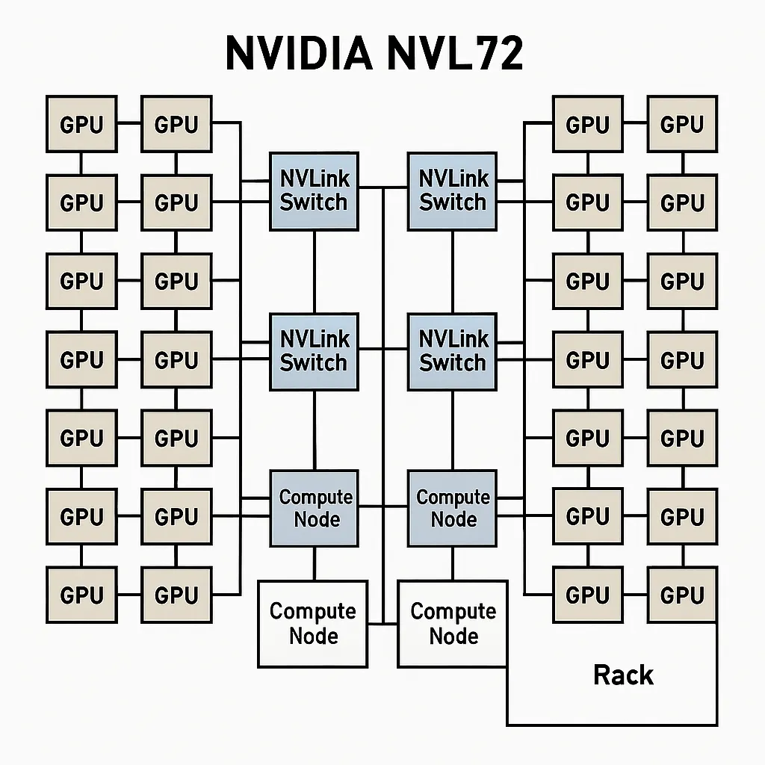
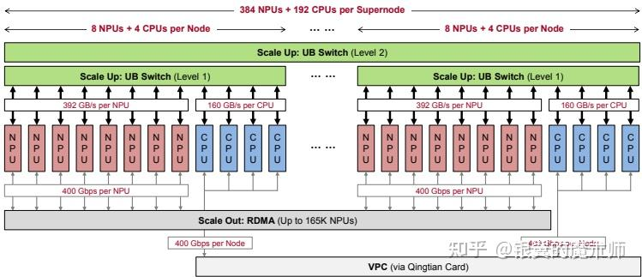
Emerging Architectures II & Outlook
Supernode Architectures
NVIDIA NVL72: "The Rack is the Chip"
Scale: 72 Blackwell GPUs interconnected via copper-backplane NVLink Switch
Goal: Emulate wafer-scale performance using discrete components
BW: Rack-level NVLink aggregate bandwidth reaches PB/s range
Huawei CloudMatrix 384: Unified Supernode
Scale: Hundreds of Ascend processors connected via HCCS protocol
Goal: Unified memory pool; balanced for both training and inference
BW: Mature CANN stack; co-evolves with FlagOS

Slide 9
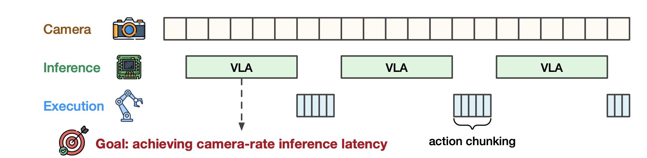
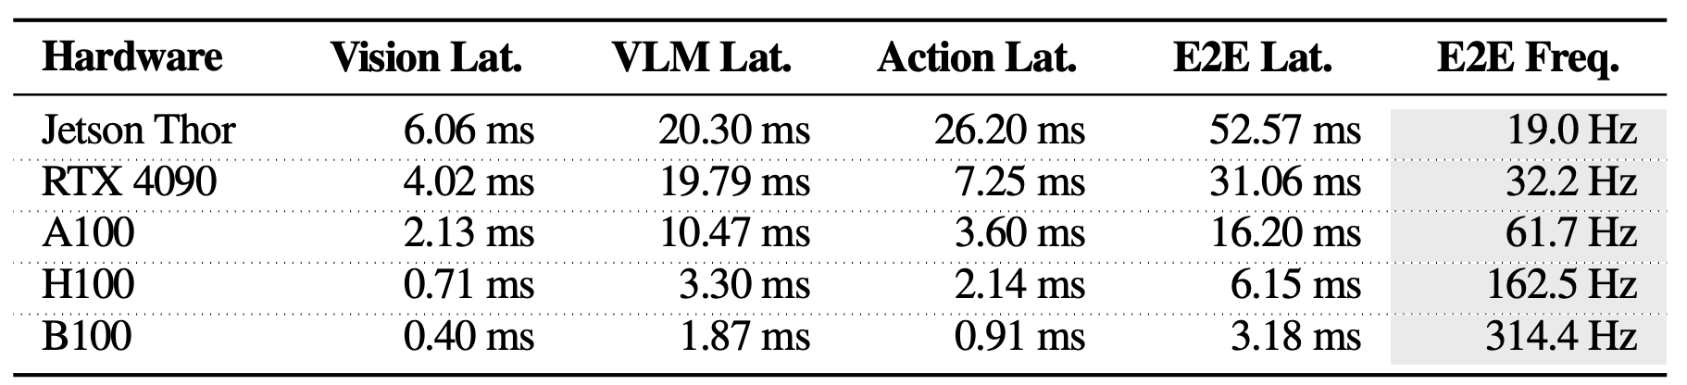
System-Level Challenges from VLA & WM
Real-Time Requirements for Robot Reasoning
Robot perception and reasoning must keep up with RGB cameras operating at 24–60 Hz.
The target inference rate ranges from 10 Hz (acceptable) to 100 Hz (high performance).
Performance Cliff on Edge Hardware
Even advanced edge GPUs (e.g., Jetson Thor) reach only ~19 Hz when running the π0 model (2.7B), making ultra-large models impractical on edge devices.
Because edge GPUs use LPDDR memory (~270 GB/s vs. ~8 TB/s HBM in data centers), the vision encoder and VLM backbone are memory-bandwidth limited, preventing full compute utilization.
How Fast Can I Run My VLA? Demystifying VLA Inference Performance with VLA-Perf，2026

Slide 10
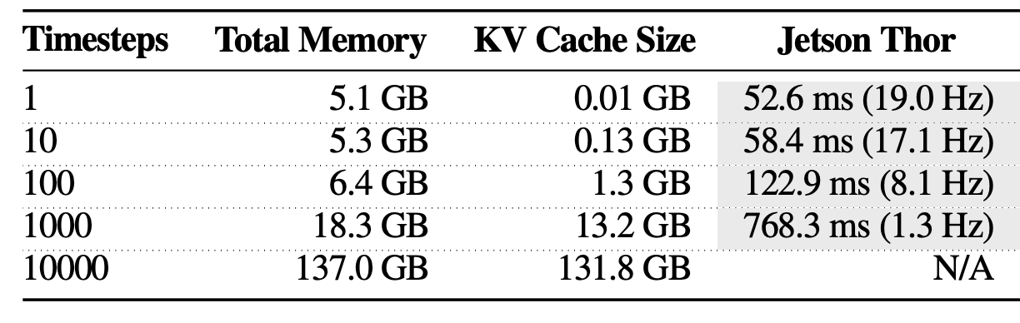
System-Level Challenges from VLA & WM
Software Stack Fragmentation
Bridging AI frameworks and robot RTOS via middleware (e.g., ROS 2) adds heavy serialization and communication overhead. In many systems, middleware latency exceeds GPU inference time.
Memory Wall from Model Scaling
14B WAM + World State Cache exceeds edge memory and bandwidth limits.
Even on GB200, WAM inference takes 5.7s; after 38× optimization still far from real-time control.
Long-Context Bottleneck
Current VLA models lack long contexts, but adding memory would create similar limits.

Slide 11
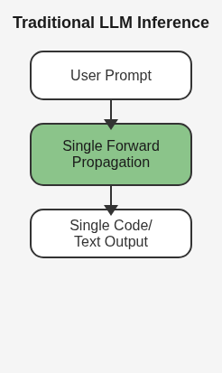
Differences between Agents and Traditional LLMs
Traditional LLM
Single-turn, deterministic, token-level autoregressive inference; compute overhead scales linearly with token count; optimizable via batch parallelism.
Agent Closed-loop autonomous decision system with multi-step nondeterministic, multimodal, multi-agent interactive continuous compute flow; compute demand undergoes paradigm shift.
Three Core Differences
1. Non-deterministic compute chain: a single task requires 5~hundreds of rounds of LLM calls, compute overhead surges 8~200x.
2. Hybrid compute paradigm: spanning inference+retrieval+tool use+interaction+reinforcement learning in heterogeneous mixed compute.
3. Persistent compute mode: shifting from burst consumption to continuous inference+online alignment+lifelong memory as persistent workload.

Slide 12
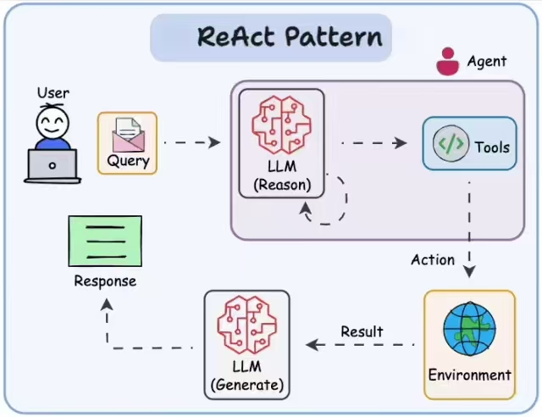
Core Challenges
Challenge 1: Compute Paradigm Disruption
Core issue: single inference evolves into iterative computation
Non-linear compute explosion: based on ReAct, ToT and similar frameworks, Agent adopts the “think-act-observe” loop; compute cost per task is tens to hundreds of times that of traditional LLM single-turn Q&A.
Compute utilization (MFU) plummets: multi-step reasoning paths diverge, rely on environment feedback; traditional large Batch Size optimization fails, causing GPU/TPU compute to idle with utilization generally below 15%.
Challenge 2: Hardware Architecture Bottleneck
Core issue: physical impact of ultra-long context on memory systems
KV Cache capacity crisis: 1M+ context windows instantly exhaust cloud GPU HBM; concurrent Agent count per GPU drops sharply.
Memory bandwidth bottleneck: frequent RAG and memory reads shift the bottleneck from compute units to data movement.
Frontier solutions: software-level PagedAttention; hardware-level Processing-in-Memory (PIM) architecture.
Notes:
单击此处添加文本

Slide 13
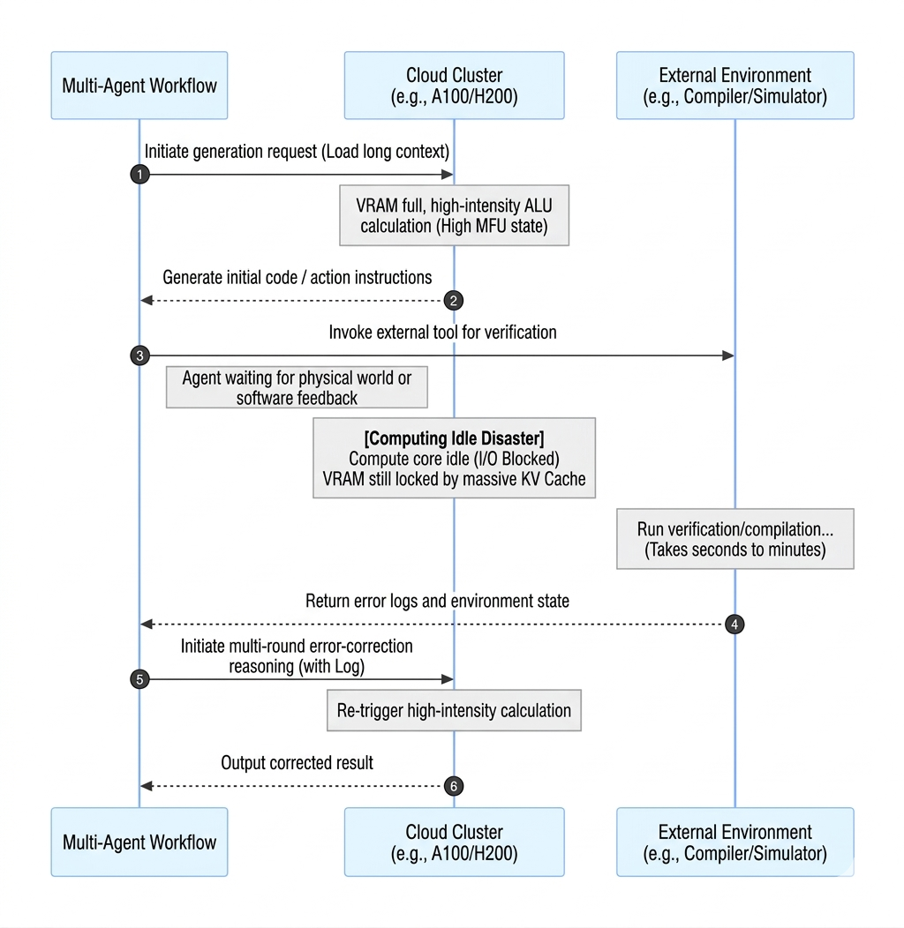
Core Challenges
Challenge 3: Interaction Pipeline Bottleneck
Core issue: interfaces to the physical world/external systems have extremely low latency tolerance; millisecond-level delays can cause task failure.
High-concurrency vs. ultra-low-latency trade-off: embodied AI and voice Agent demand time-to-first-token (TTFT) and inter-token latency (ITL) at millisecond-level limits, beyond the reach of traditional architectures.
I/O blocking causes compute waste: uncontrollable I/O waits during external tool calls; slow OS context switching causes expensive AI compute to be wasted idle.
Challenge 4: Compute Distribution Restructuring
Core issue: compute is no longer confined to a single node; network communication becomes an extension of compute.
Communication bandwidth equals effective compute: under the “edge sensing, cloud planning” model, seamless context migration critically depends on high-bandwidth, low-latency networks.
Heterogeneous compute scheduling: tasks must be dynamically partitioned and offloaded across edge NPU, edge CPU, and cloud GPU; intelligent routing mechanisms are urgently needed.
Notes:
Image: GPU compute resources severely wasted while “waiting for external environment feedback”

Slide 14

The Solution: FlagOS, a Unified AI Software Stack

Slide 15








https://space.bilibili.com/3546791834290849
https://github.com/flagos-ai
https://www.zhihu.com/people/95-22-20-18/posts
https://flagos.io/Home

Slide 16

Thanks for your time！

